Slide 1
Pre-Training Methods
Plaban Kumar Bhowmick
Department of AI
plaban@ai.iitkgp.ac.in

Slide 2
Pre-Training Map
Pre-Training
Methods
Tasks
Pre-training from Scratch
Causal LM
Continual Pre-training
Masked LM
Simultaneous Pre-training
Replaced Token Detection
Task Adaptive Pre-training
Shuffled Token Detection
Knowledge Inherited Pre-training
Denoising Autoencoder
** Kalyan et al., AMMUS : A Survey of Transformer-based Pretrained Models in Natural Language Processing

Slide 3
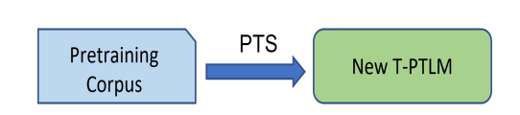
Pre-Training Methods
Pretraining from Scratch (PTS)
T-PTLM → Transformer-based Pretrained Language Model
All layers Embedding, Encoding and (or) Decoding are
randomly initialized
Computationally expensive
For example: BERT, GPT

Slide 4
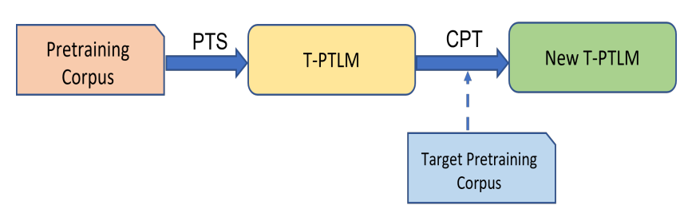
Pre-Training Methods
Continual Pretraining (CPT)
Initialized with some pretrained models
Further pretrained with domain specific dataset
Requires less training time and computational resources
Adapt to domain specific vocabulary for the target domain
Catastrophic Forgetting: Overfit to domain specific corpus, losing generalizability
For example: BioBERT, HateBERT
Ke et al., Continual pre-training of large language models, ICLR, 2023

Slide 5
Continual Domain Adaptive Pre-Training (DAP)
Sequence of unlabeled domain corpora to adapt the LM to these domains
Soft-masking mechanism that directly controls the update to the LM
Mechanism to preserve the general knowledge in the original LM
It contrasts the representations of the previously learned domain knowledge (including the general knowledge in the pre-trained LM) and the knowledge from the current full network to achieve knowledge integration.
Overcomes catastrophic forgetting, but also achieves knowledge transfer to improve end-task performances

Slide 6
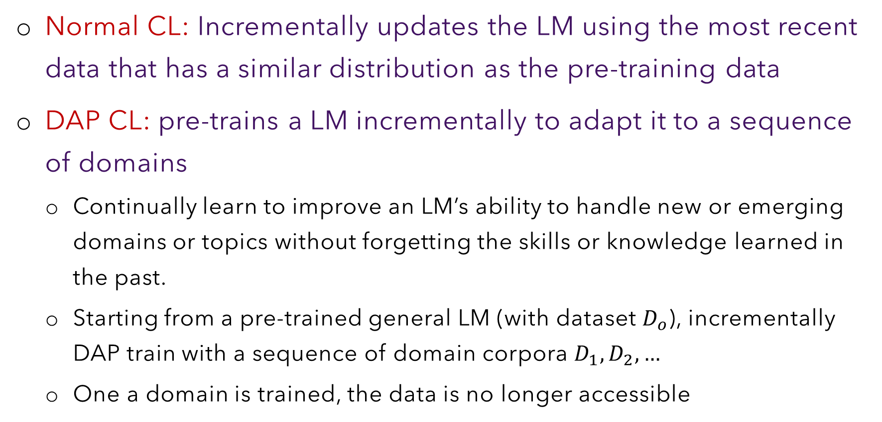
CL vs DAP CL
Normal CL: Incrementally updates the LM using the most recent data that has a similar distribution as the pre-training data
DAP CL: pre-trains a LM incrementally to adapt it to a sequence of domains
Continually learn to improve an LM’s ability to handle new or emerging domains or topics without forgetting the skills or knowledge learned in the past.
Starting from a pre-trained general LM (with dataset $D_{o}$), incrementally DAP train with a sequence of domain corpora $D_{1},D_{2}, …$
One a domain is trained, the data is no longer accessible

Slide 7
DAP CL Requirement
It should not suffer from catastrophic forgetting (CF)
to overcome CF for each new domain
to overcome CF for the general language knowledge in the LM
It should encourage knowledge transfer (KT) across domains
Forward transfer: learning a new domain by leveraging the knowledge from previous domains
Backwards transfer: gaining improved performance on previous domains after learning a relevant new domain
It should work without requiring the domain-ID for each end-task fine-tuning

Slide 8
Two Key Ideas
(1) Preserving the important general language knowledge in the LM and the knowledge learned from previous domains to overcome CF by soft-masking units based on their importance
(2) Encouraging the model to learn complementary representations of the current domain and previous domains

Slide 9
Workflow
DAP Learning
Initialization
Continual Learning
computes the importance of units to the general language knowledge in the LM
is done before the continual learning starts
Domain Training
Importance Computation
takes the importance scores accumulated so far
input data of the current domain to learn the domain
computes the importance scores for the current domain for future use

Slide 10
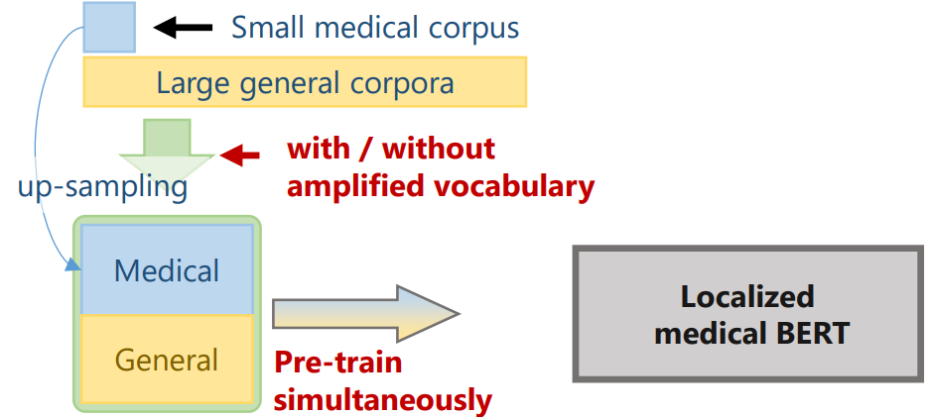
Pre-Training Methods
Simultaneous Pretraining (SPT)
Pretrain from scratch using a corpus having both general and
domain-specific text
Up sampling of domain-specific text is done to ensure a
good number of domain-specific terms
Wada et al., Pre-training technique to localize medical BERT and enhance biomedical BERT

Slide 11
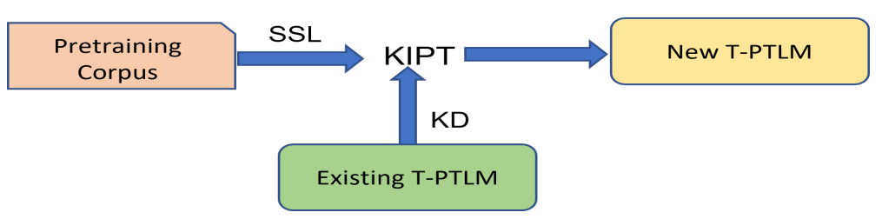
Pre-Training Methods
Knowledge Inherited Pretraining (KIPT)
How could existing PLMs benefit training large-scale PLMs in future?
Knowledge Inheritance: Distil the knowledge summarized by an existing small PLM during pretraining to efficiently learn larger PLMs
Self learn → Self supervised learning
Learn from others → Knowledge distillation
Qin et al., Knowledge Inheritance for Pre-trained Language Models, 2022

Slide 12










Pre-Training Methods
Knowledge Inherited Pretraining (KIPT)
Textual input:
Label:
Logits for :
Softmaxing:
Pretraining objective:
Teacher
Develop a well-trained small PLM ( ) : optimizing
Student
Use to train a larger PLM with corpora

Slide 13

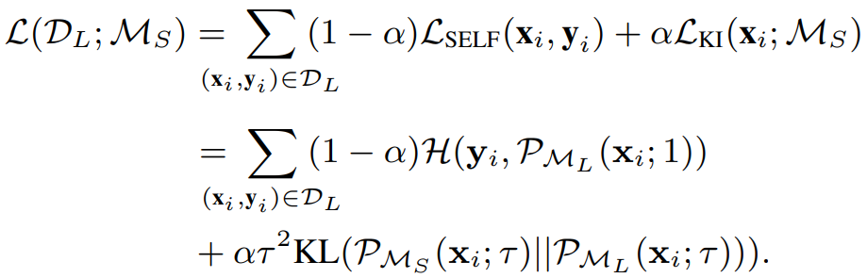
Pre-Training Methods
Knowledge Inherited Pretraining (KIPT)
Knowledge Distillation: Bringing the student’s ( ) knowledge closer to that of the teacher ( )
→ Minimizing the Kullback-Leibler (KL) divergence between two probability distributions for the same input

Slide 14






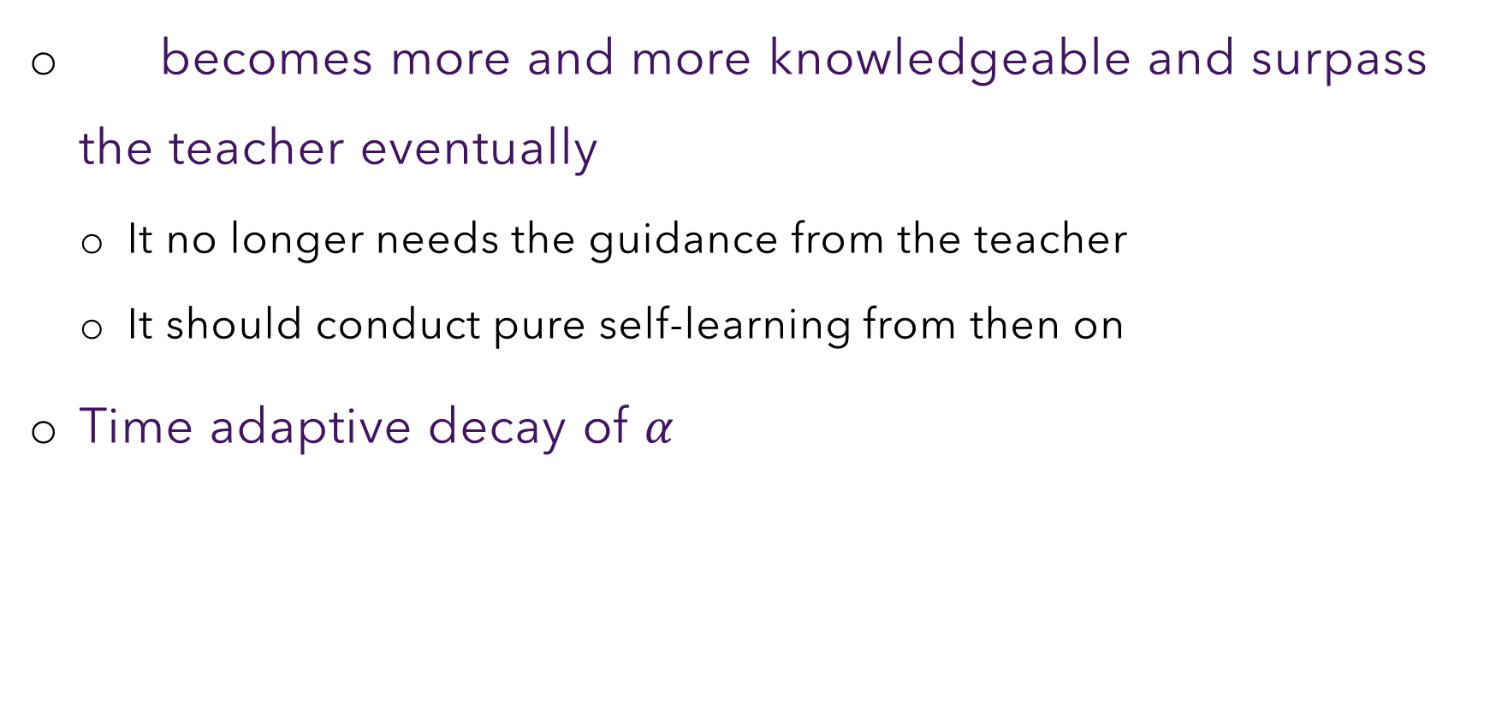
When a Student Surpasses the Teacher?
becomes more and more knowledgeable and surpass the teacher eventually
It no longer needs the guidance from the teacher
It should conduct pure self-learning from then on
Time adaptive decay of $α$
Linear decay with slope = $\frac{α_{T}}{T}$
Inheritance continues till for $\frac{T}{α_{T}}$ steps

Slide 15
Pre-Training Tasks

Slide 16
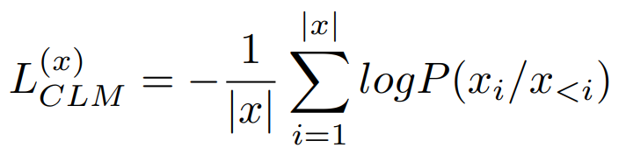
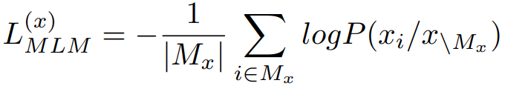
Pre-Training Tasks
Causal Language Modelling
Raw training data sequence:
When we hear the bell ringing
Processed training data sequence:
When we hear the bell ________________
Masked Language Modelling
Raw training data sequence:
When we hear the bell ringing
Processed training data sequence:
When we [MASK] the bell [MASK]

Slide 17
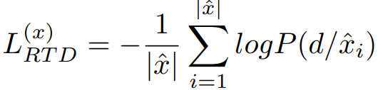
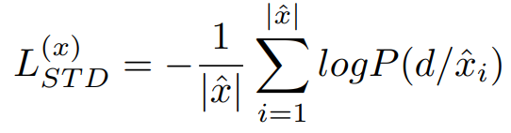
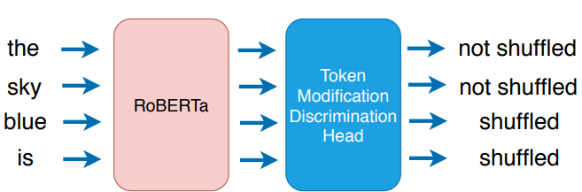


Pre-Training Tasks
Replaced Token Detection
$$d∈\{0,1\}$$
A token is replaced or not
Raw training data sequence:
When we hear the bell ringing
Processed training data sequence:
When we ate the bell dead
Shuffled Token Detection
$$d∈\{0,1\}$$
A token is shuffled or not

Slide 18
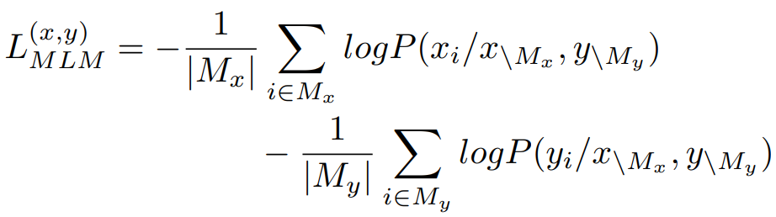
Pre-Training Tasks
Translation Language Model
Cross lingual pretraining
Raw training data sequence:
<we will know immediately that our enemy is coming.
हमें तुरंत पता चल जाएगा कि हमारा दुश्मन आ रहा है>
Processed training data sequence:
<we will [MASK] immediately [MASK] our enemy [MASK] coming.
हमें [MASK] पता [MASK] जाएगा कि हमारा [MASK] आ रहा है>

Slide 19
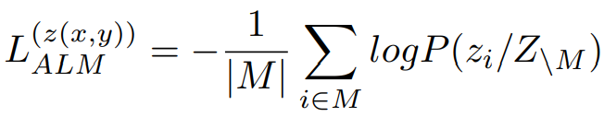
Pre-Training Tasks
Alternating Language Model
Cross lingual pretraining/Code Mixing
Raw training data sequence:
<Buddy, keep tomorrow’s meeting bit late because I have a doctor’s appointment tomorrow.
Yaar, kal ……… kaal doctor se molakat hain>
Processed training data sequence:
Yaar, kal meeting thodi late rakhna, kiunki subha I have a doctor’s appointment

Slide 20
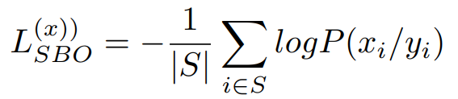
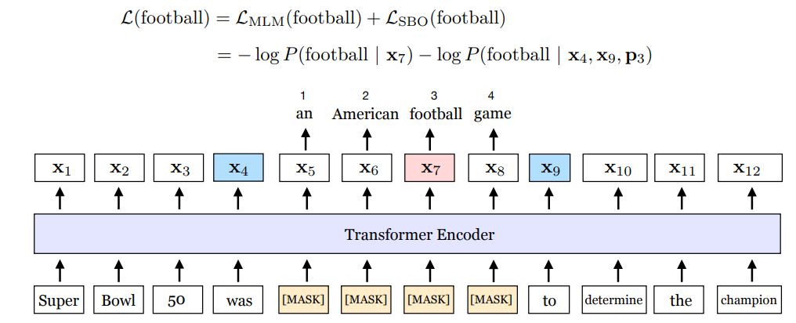

Pre-Training Tasks
Span Boundary Objective
$$y_{i}=f(x_{s−1}, x_{e+1}, p_{i−s+1})$$
S → positions of tokens in contiguous span
Perform better in downstream tasks like entity extraction, coreference resolution, and question answering which involves span-based extraction

Slide 21


Pre-Training Tasks
Next Sentence Prediction
Training data sequence:
Bill hid the car key. He was drunk.
Bill hid the car key. An octopus has eight tentacles.
Good in capturing topic but not coherence.
Sentence Order Prediction
Training data sequence:
Bill hid the car key. He was drunk.
He was drunk. Bill hid the car key.

Slide 22
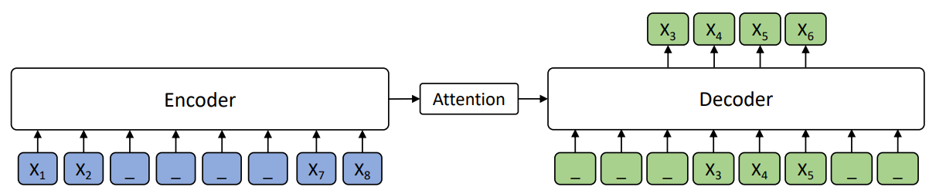

Pre-Training Tasks
MAsked Sequence to Sequence LM
$$L_{MASS}^{(x)}=−\log{P\left(x^{s:e} | x_{\backslash s:e}\right)}$$
$$=−\log{\prod_{t=s}^{e}{P\left(x_{t}^{s:e} | x_{<t}^{s:e},x_{\backslash s:e}\right)}}$$
Song et al., MASS: Masked Sequence to Sequence Pre-training for Language Generation

Slide 23
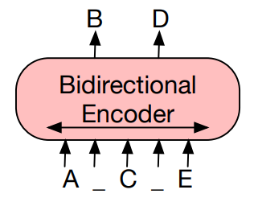
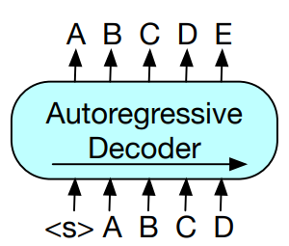
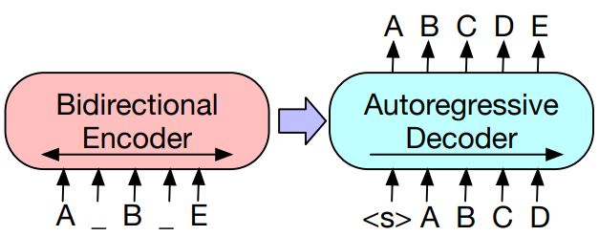
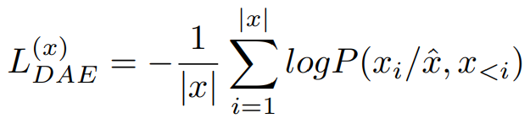
Pre-Training Tasks
Denoising Autoencoder
Lewis et al., BART: Denoising Sequence-to-Sequence Pre-training for Natural Language Generation, Translation, and Comprehension

